Slide 1
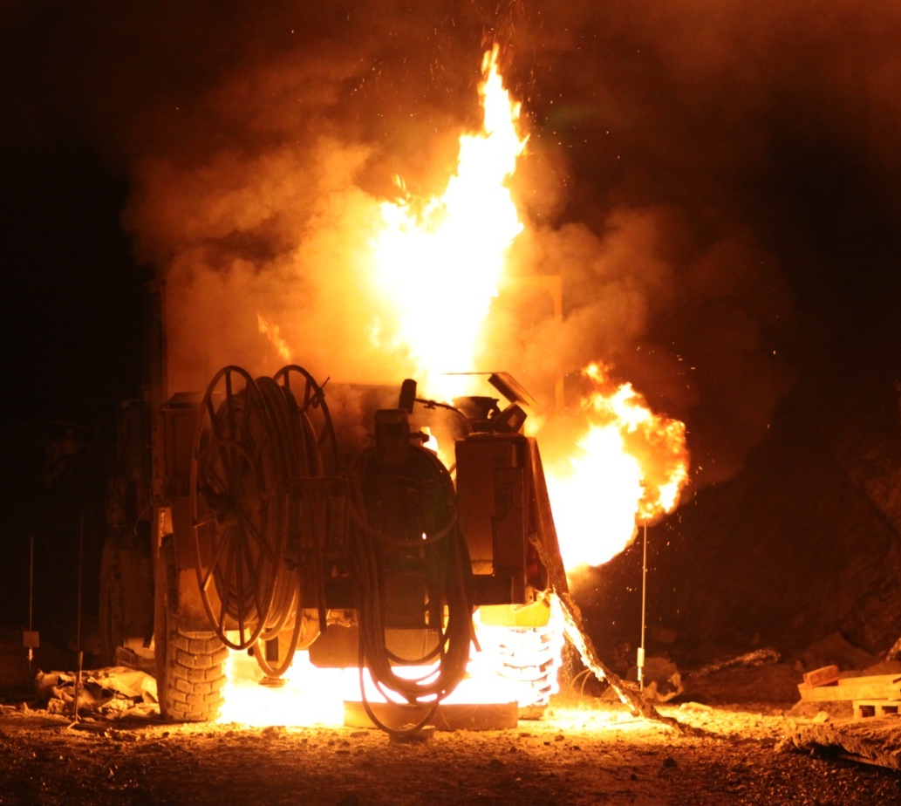
Fires in underground hard rock mines
Rickard Hansen
Notes:
This presentation will deal with fires in underground mines. Even though it deals with underground mines, the same risks, fire behavior etc will apply to a number of other underground facilities as well. The nature of coal mines are very specific and will not be dealt with in this presentation.

Slide 2
Fires in mines
Notes:
Fire has been present in the life of miners and influenced their lives since ancient times. Firesetting – i.e. heating up the rock with a fire and then in some cases rapidly cooling the rock by applying water – was used several thousands of years ago for breaking rocks in mines and played a major role in the industry. Today the miners will not regard fires as an important working method but instead as a major risk. It is one thing that they are truly scared of.

Slide 3
The environment
Access by elevator or ramp.
Complexity; 3-D aspect; ever changing layout.
Limited access/road system in some cases.
More or less fixed ventilation possibilities. But the ventilation flows will vary.
Darkness.
Notes:
The vastness, three dimensional aspect and the ever changing layout of a mine will increase the demands on the fire personnel with respect to orientation and knowledge of the object.

Slide 4
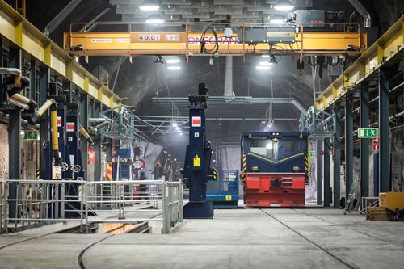
Workshops; canteen; storage facilities; crusher stations; transportation drifts; shafts etc.
Ore transport by train or truck.
Difficult with barriers in some areas.
Large number of vehicles. Heavy vehicles.
Extremely long distances.

Slide 5
Risks in general
Explosives.
Falling rocks.
Gases.
Flooding.
Open shafts.
Flammable liquid and gases.
Fires in heavy vehicles, conveyor belts etc.
Smoke spread.
Notes:
The risks the firefighters and miners face during a fire in an underground hard rock mine are numerous and extensive if not properly addressed. The risks will vary from mine to mine but could for example be explosives, flammable liquid, fires in large heavy trucks, tire explosions, falling rocks due to temperature variations, open shafts and personnel being trapped.

Slide 6
Fire behavior
Extensive smoke spread in length + 3-D + mechanical ventilation.
Smoke stratification only at the fire vicinity. Fire gases cools down rapidly. Poor visibility.
Due to the general vastness and openess of the mine drift and most combustibles found at the lower part, flame radiation will dominate as the spread mechanism.
Notes:
The fire behaviour in a mine drift is highly dependent upon the arrangement and distribution of the adjacent combustible items, the dimensions of the mine drift as well as the ventilation conditions and the access to air. An underground mine presents a unique environment with respect to fire behavior and smoke spread. The smoke spread will be extensive in length and three dimensional. The mechanical ventilation will be a key factor: it will tilt the flames and increase the flame spread velocity, provide additional oxygen to the fire, affect the stratification and of course the smoke spread (backlayering etc.).
As the combustible materials in an underground mine can generally be found concentrated at certain positions, the likelihood of the fire spreading from the first item ignited is generally small. The few positions in an underground mine where a continuity in fuel and high fire load can be found are office complexes, warehouses and parking drifts with several vehicles parked at short distances.

Slide 7
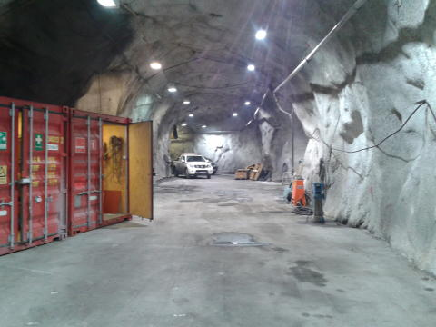
Combustible materials generally found concentrated at certain positions, the likelihood of the fire spreading from the first item is generally small.
Flashover not likely in an open mine drift.
Spray fires – hydraulic equipment.

Slide 8
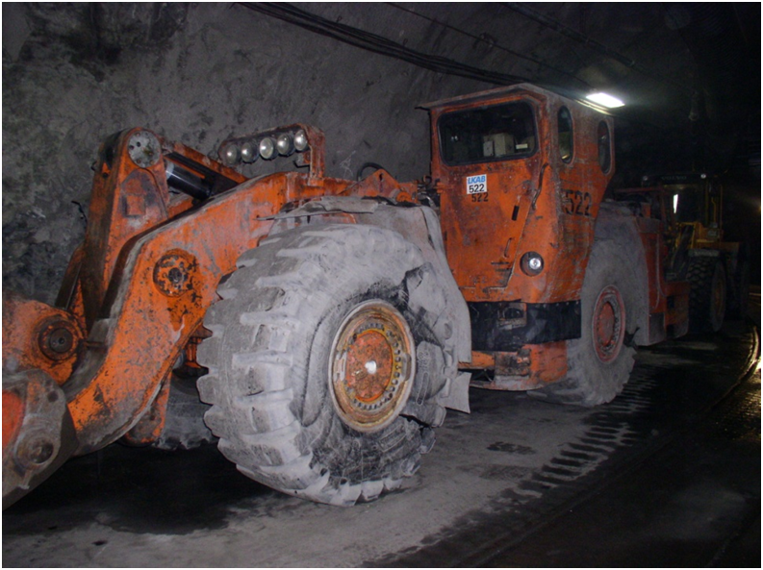
Vehicle fires
Vehicles found in almost all parts of a mine.
Large amounts of tyre, diesel, hydraulic oil, hydraulic hoses, cables etc.
Rapid fire growth.

Slide 9
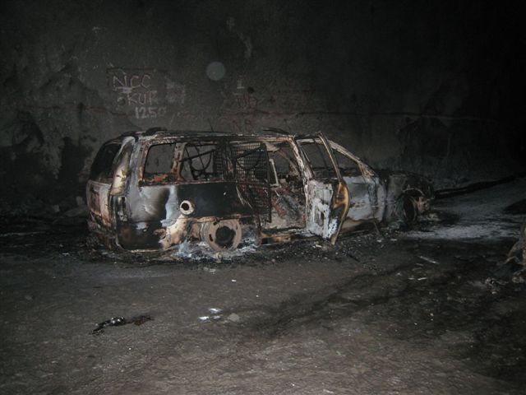
Considerable smoke production.
Long lasting fires.
Most common type of fire.
Most dangerous fire under ground.

Slide 10
Fire and rescue service
Attack routes – evacuation routes.
Lack of barriers – use ventilation.
Should we ventilate while the evacuation is still going on?
Smoke ventilation – where will the smoke end up?
Miners in refuge chambers, will the air last?
Notes:
Fire gas ventilation – as opposed to above ground it is not simply to open a window or a door to ventilate. The smoke will also end up somewhere else which could worsen things.
The smoke ventilation options during the early phases may be limited and often colliding with the need for evacuation routes.
An example is a vehicle fire – involving a passenger vehicle – in a ramp in the Malmberget mine in north-ern Sweden in 2008, where the fire and rescue personnel initially had to turn back when attempting to reach the fire due to an extensive smoke spread blocking the path of attack. Meanwhile 8 mining personnel were unable to evacuate and had to use a refuge chamber designed for 6 people. As they were two breathing masks short, they decided that either should nobody use the air supply or else they should share it equally. They shared equally. This also highlights the refuge chamber – fire duration question which could be a pressure for the rescue personnel (rescue the miners before the air is out). Also the entire fire curve is of interest – not just the pre-flashover part.
The choice of extinguishing agent will have to be considered throughout the intervention as it may affect the safety of the firefighters due to the risk of falling rocks.

Slide 11
Choice of extinguishing agent.
Falling rocks.
Backlayering.
Extremely long distances.
Fire and rescue units stationed under ground.

Slide 12
Challenges ahead
Quantifying different types of fires – smoke ventilation.
Modelling mine fires. Fire perspective!
How much air should the refuge chamber contain?
Design and construction of mining vehicles.

Slide 13
Fire experiments in an underground mine

Slide 14
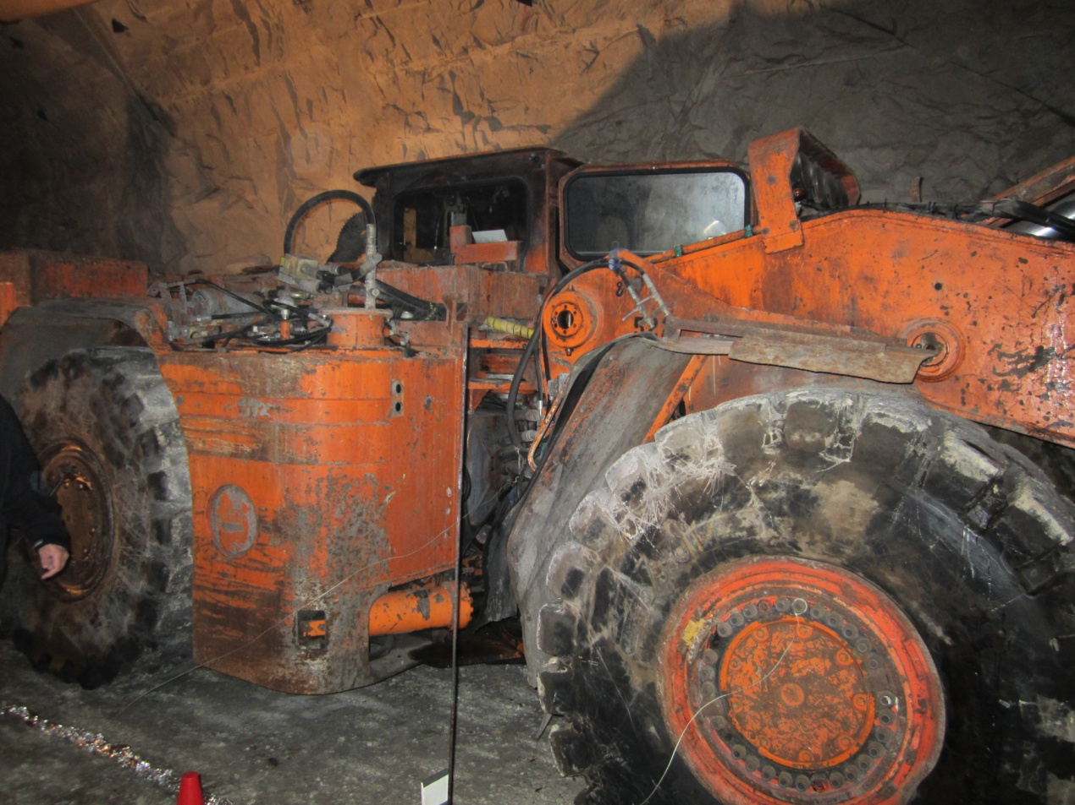

Slide 16
